Slide 1

Heart Failure Prediction
Samuel Kim

Slide 2
The problem
Introduction
Context
Problem statement
Cardiovascular diseases are the number one cause of death.
eighteen million lives each year (thirty-one percent worldwide).
Four out of five deaths in cardiovascular diseases are due to heart attacks and strokes.
one-third of these deaths occur prematurely in people under seventy years of age.
This dataset contains twelve features that can be used to predict a possible heart disease: Age, Sex, Chest Pain Type, Resting Blood Pressure, Cholesterol, Fasting Blood Sugar, resting electrocardiogram results, Max Heart Rate, exercise-induced angina, Old_Peak, the slope of the peak exercise ST segment, and heart disease.
People with cardiovascular disease or who are at high cardiovascular risk is due to the presence of one or more risk factors. Therefore, machine learning can be a great asset to the early detection and management of people who have cardiovascular disease or who simply have high cardiovascular risk.

Slide 3
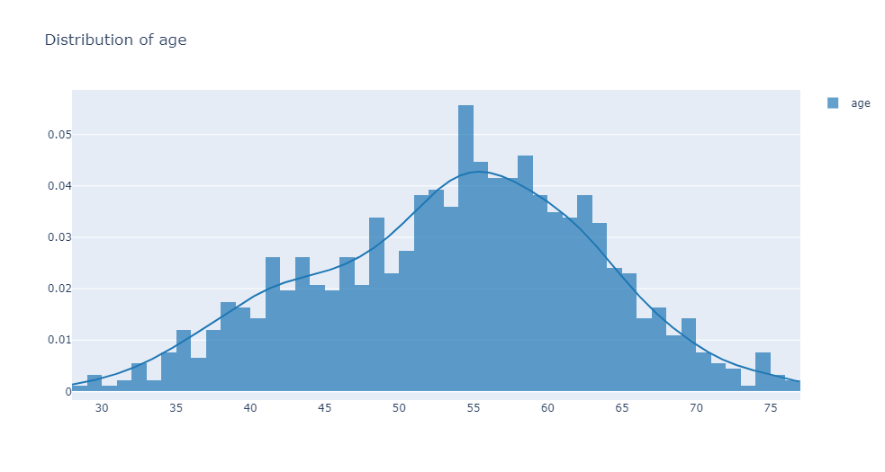
Distribution of Age

Slide 4
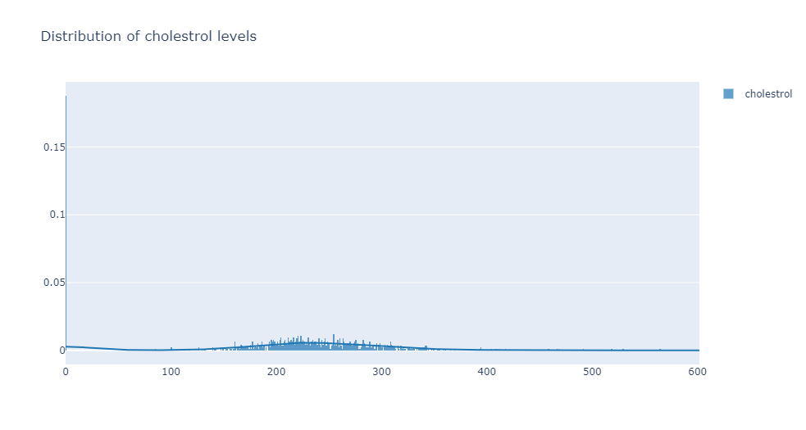
Cholesterol Levels

Slide 5
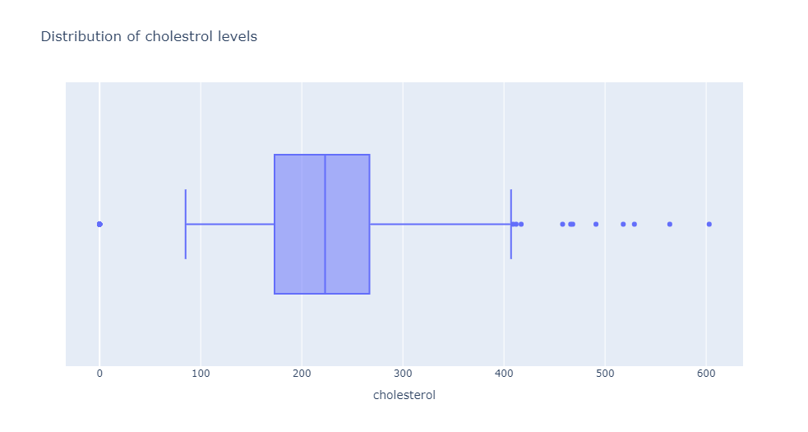
Cholesterol Levels

Slide 6
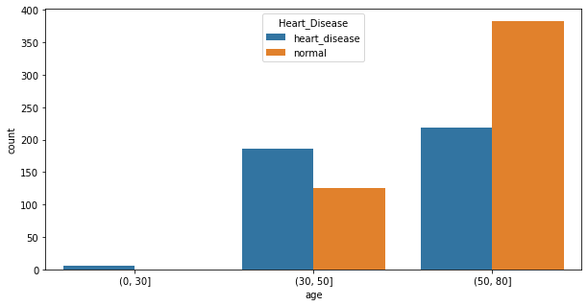
Age 50 older are more likely to have heart disease.

Slide 7
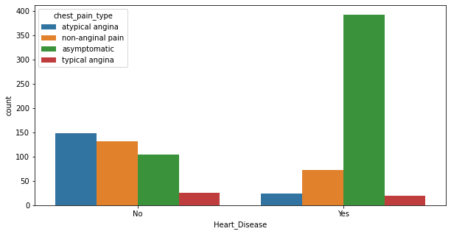
Asymptomatic is the most common within patients.

Slide 8
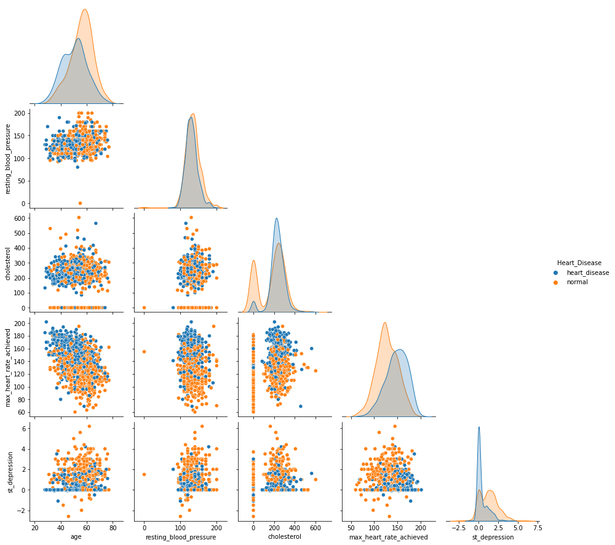
Pairplot with Heart Disease

Slide 9
Logistic Regression
precision recall f1-score support
0 0.88 0.83 0.86 119
1 0.88 0.92 0.90 157
Accuracy 0.88 276
macro avg 0.88 0.87 0.88 276
weighted avg 0.88 0.88 0.88 276

Slide 10
Random Forest Classification
precision recall f1-score support
0 0.88 0.84 0.86 116
1 0.89 0.91 0.90 160
accuracy 0.88 276
macro avg 0.88 0.88 0.88 276
weighted avg 0.88 0.88 0.88 276

Slide 11
SVC
precision recall f1-score support
0 0.88 0.87 0.87 113
1 0.91 0.91 0.91 163
accuracy 0.89 276
macro avg 0.89 0.89 0.89 276
weighted avg 0.89 0.89 0.89 276

Slide 12
Cat Boost
precision recall f1-score support
0 0.89 0.88 0.88 114
1 0.91 0.93 0.92 162
accuracy 0.91 276
macro avg 0.90 0.90 0.90 276
weighted avg 0.91 0.91 0.91 276

Slide 13
LGBM Classifier
precision recall f1-score support
0 0.87 0.83 0.85 117
1 0.88 0.91 0.89 159
accuracy 0.87 276
macro avg 0.87 0.87 0.87 276
weighted avg 0.87 0.87 0.87 276

Slide 14
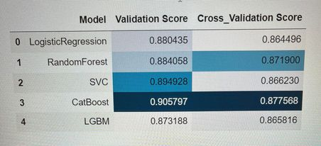
Best Result

Slide 15
Conclusion
As we can see, all of our models obtained decent results within the validation and cross validation score.
We can see that the Light GBM model performed the worst than the Logistic Regression, SVC, and Random Forest within the validation score.
It seems CatBoost performed the best within the validation score
Within the cross validation score we can see that Logistic Regression performed the worst.
While CatBoost seems to performed the best within the cross validation score as well

